Slide 1
Visually-based Fall Detection System with IoT Alarming system
Department of Electronic & Electrical Engineering Faculty of Engineering Sciences
ZIWEI XU Supervisor: Prof. Nathan Gomes
Notes:
The banner on the title slide is larger than on the other slides and contains information about the department. Add your project title, name and supervisor name.

Slide 2
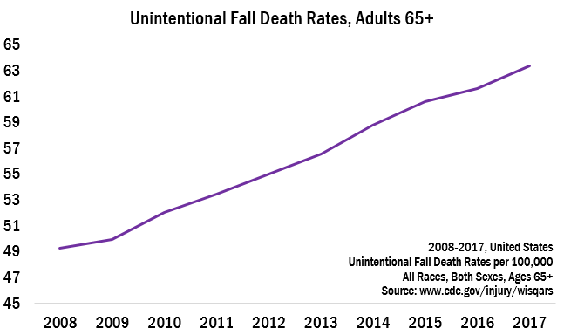
The problem statement & Objectives
With the increase of the aging population and their frailty, over 300 thousands people die every year due to unintentional falls and over 44% of them happened at home.
Design a visually-based fall detection system for the elderly with IoT alarm to the mobile devices.
Figure 1:Unintentional Fall Death Rates table
Reference:
CDC’s STEADI Toolkit. (2018). Unintentional Fall Death Rates, Adults 65+ [Photograph]. Flickr. http://www.cdc.goc/injury/wisqar
Notes:
The banner on subsequent slides should contain your name, project title and affiliation. You need to change this information in the “Slide Master” (View -> Slide Master). The total number of slides needs to be changed in the “Slide Master” too.

Slide 3
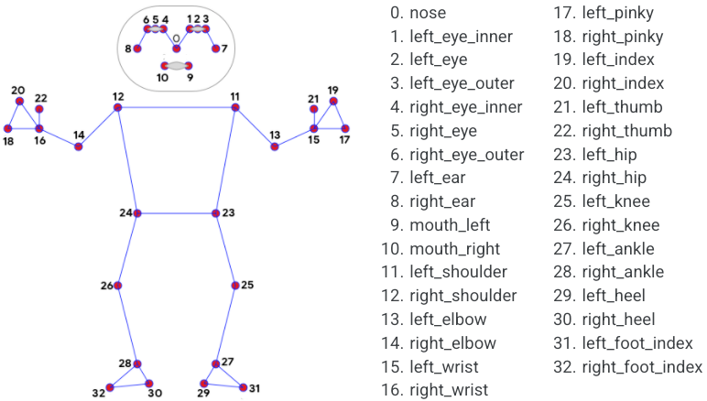
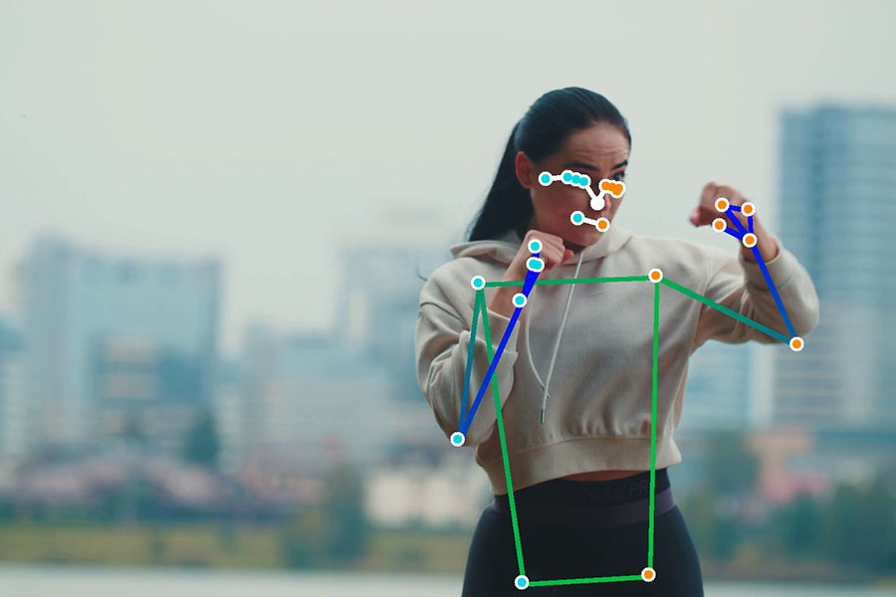

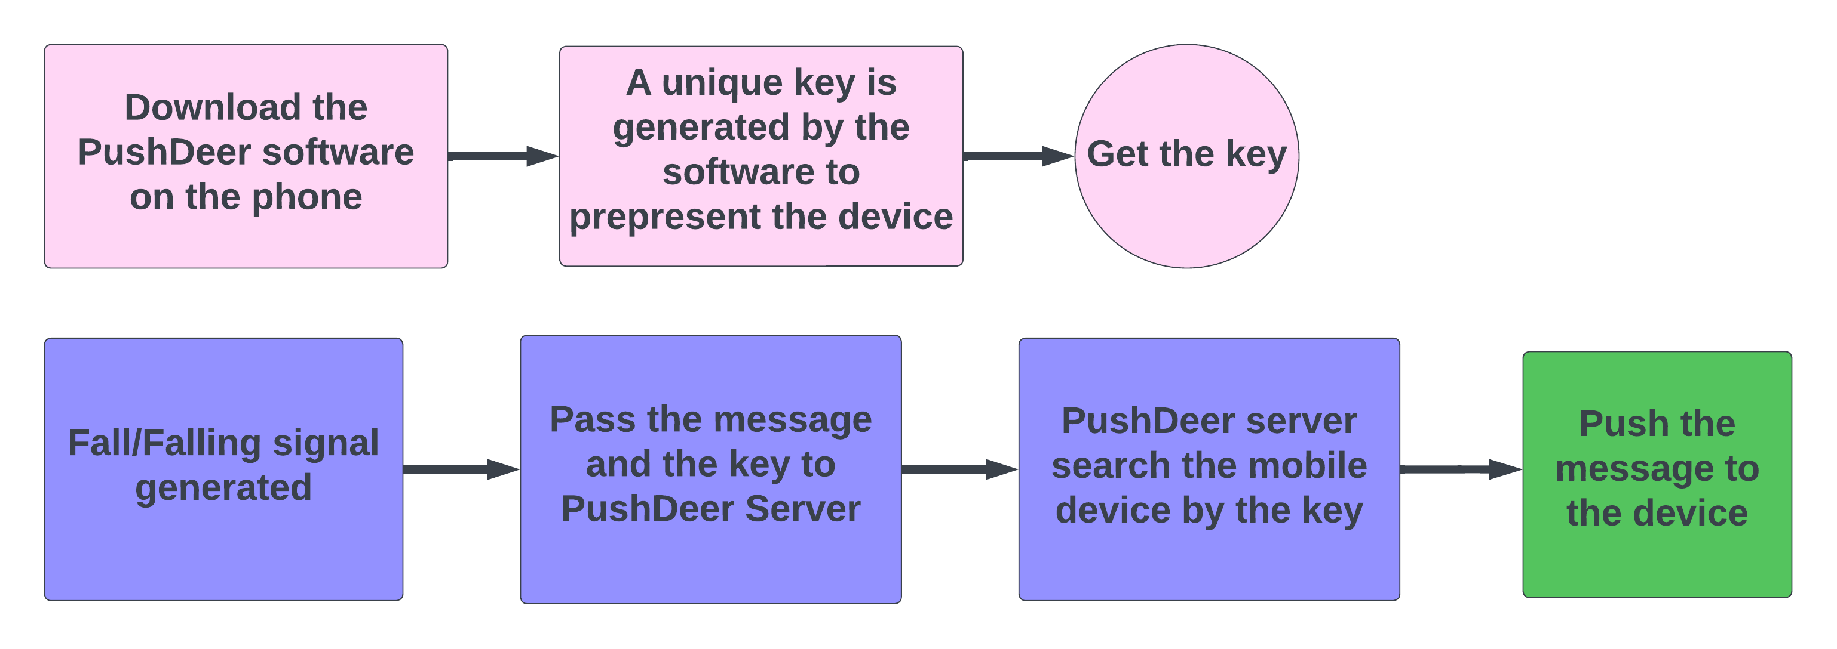
Software in this project
Visually-based Fall detection system
Mediapipe: This is a Machine Learning solution for body skeleton landmarks tracking and extraction. Each landmarks was generated into a list contains [ x, y, z, visibility ]. And each frame contains 33 landmarks.
OpenCV: This is a library of function for real time computer vision. It can be used to extract the frames from the video.
IoT alarming system
PushDeer: This is a software that can push the message from PC to the phone. The generated fall and falling messages were pushed to the mobile device by this software.
Figure 2: Mediapipe landmark extraction explanation
Figure 3: Mediapipe landmark extraction sample
Figure 4: PushDeer
Figure 5: Flowchart of the IoT alarming system
Reference:
Mediapipe pose.(2023).pose landmarks.[Photograph].Flickr. https://google.github.io/mediapipe/solutions/pose.html
Mediapipe pose.(2023). Example of MediaPipe Pose.[Photograph].Flickr. https://google.github.io/mediapipe/solutions/pose.html
PushDeer.(2023).PushDeer Logo.[Photograph].Fliker. http://www.pushdeer.com/official.html
Notes:
The banner on subsequent slides should contain your name, project title and affiliation. You need to change this information in the “Slide Master” (View -> Slide Master). The total number of slides needs to be changed in the “Slide Master” too.

Slide 4
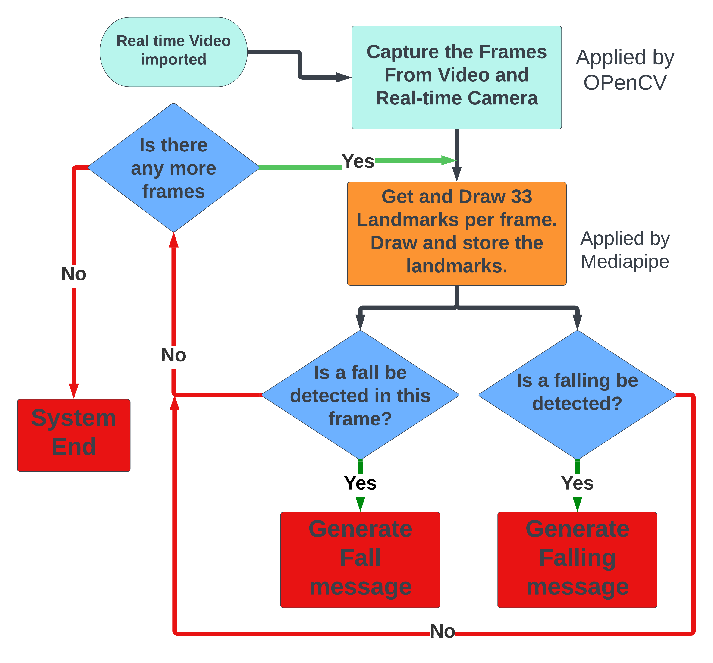
Fall & Falling detection system
Flow chart of fall and falling detection system
The cyan squares show the data receiving process;
The orange square shows the pre-processing part;
The blue rhombuses are fall and falling detection parts;
The red squares are outputs.
Parameters
s_h_high: the height from shoulder to hip
s_h_long: the length from shoulder to hip
h_f_high: the height from hip to feet
h_f_long: the length from hip to feet
Figure 6: Flowchart of Fall & Falling detection system
Notes:
The banner on subsequent slides should contain your name, project title and affiliation. You need to change this information in the “Slide Master” (View -> Slide Master). The total number of slides needs to be changed in the “Slide Master” too.

Slide 5
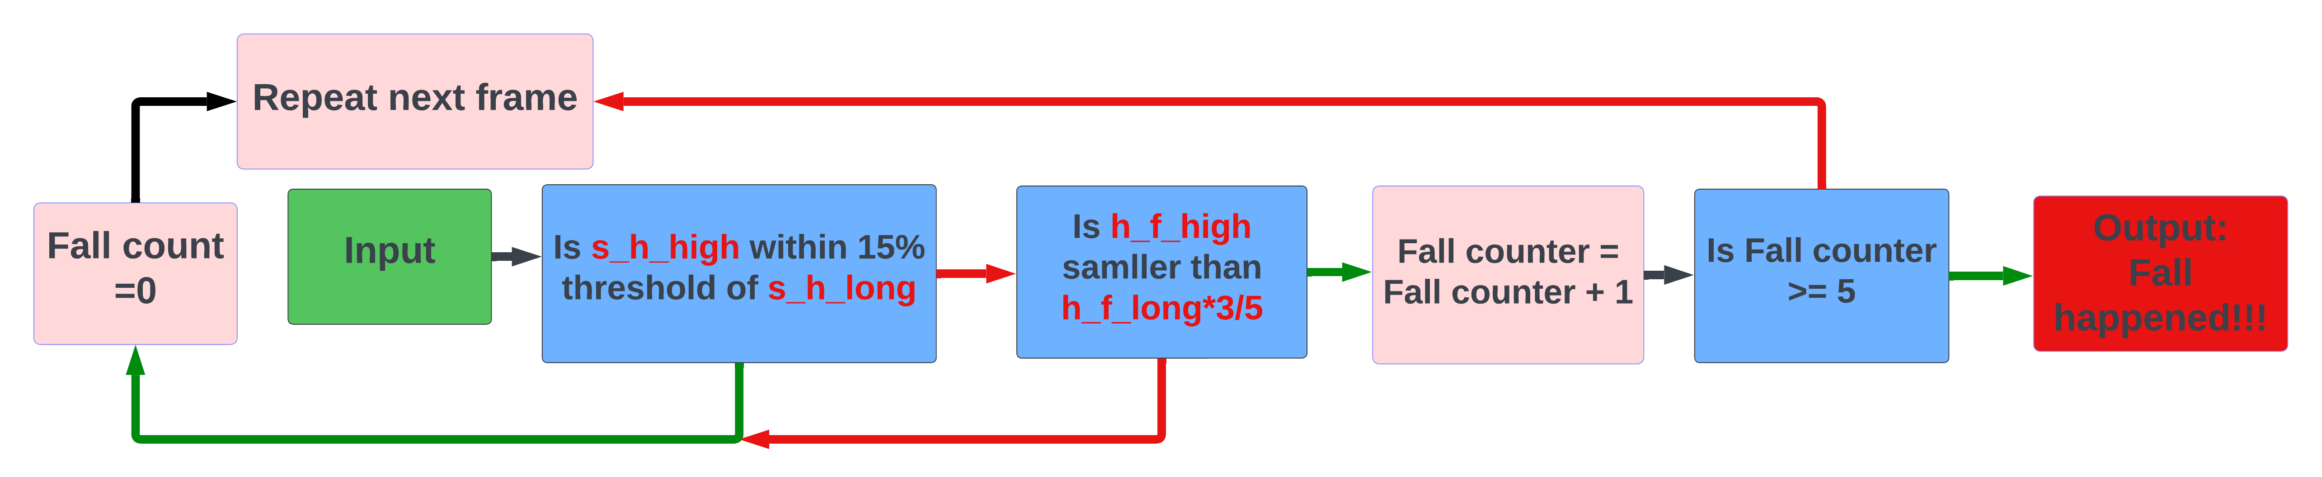
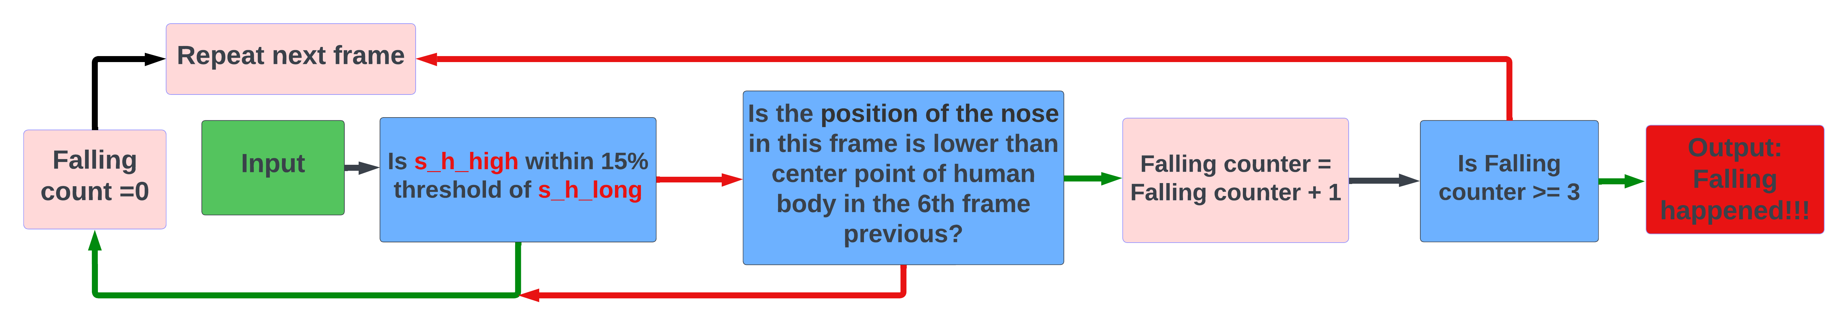
Fall & Falling detection algorithms
Figure 7: Flowchart of Fall detection algorithm
Figure 8: Flowchart of Falling detection algorithm

Slide 6
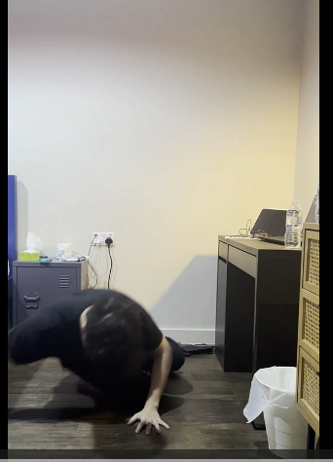
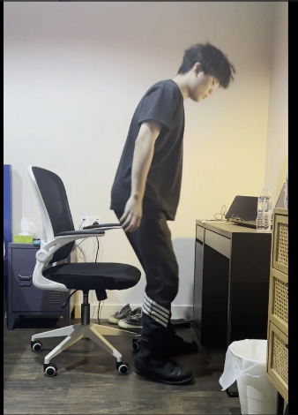
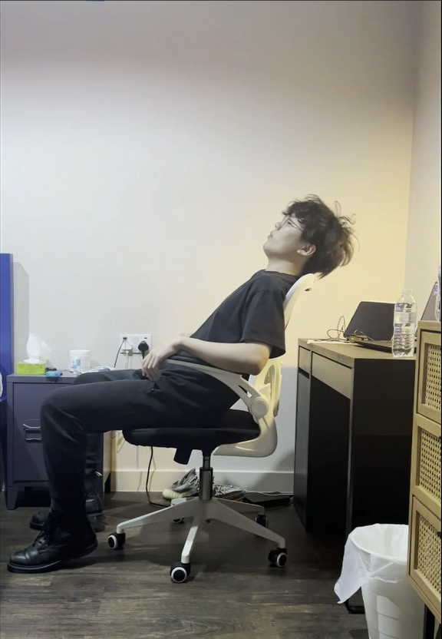
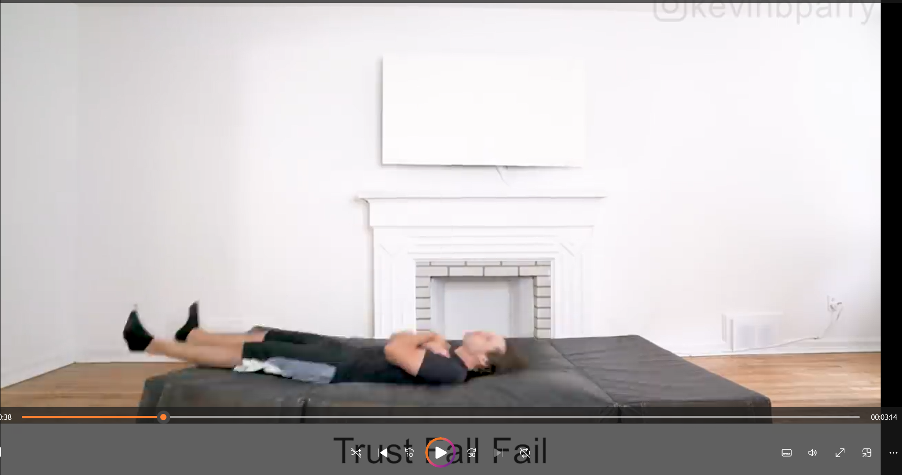
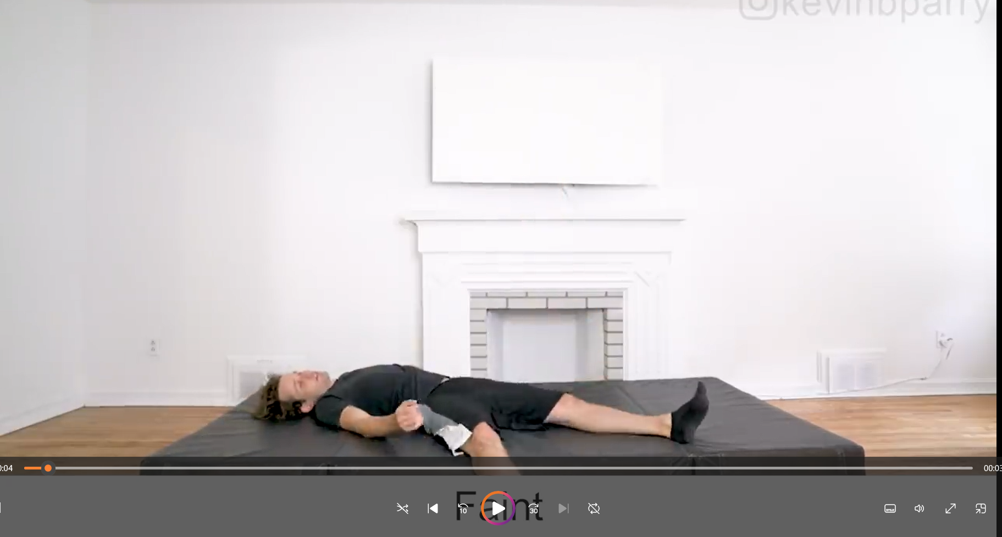
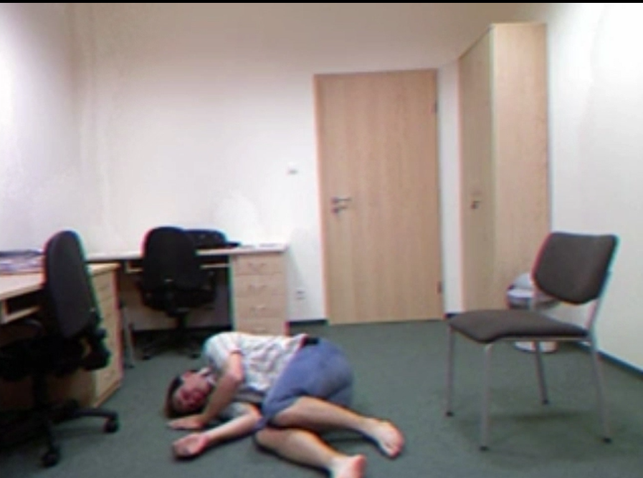
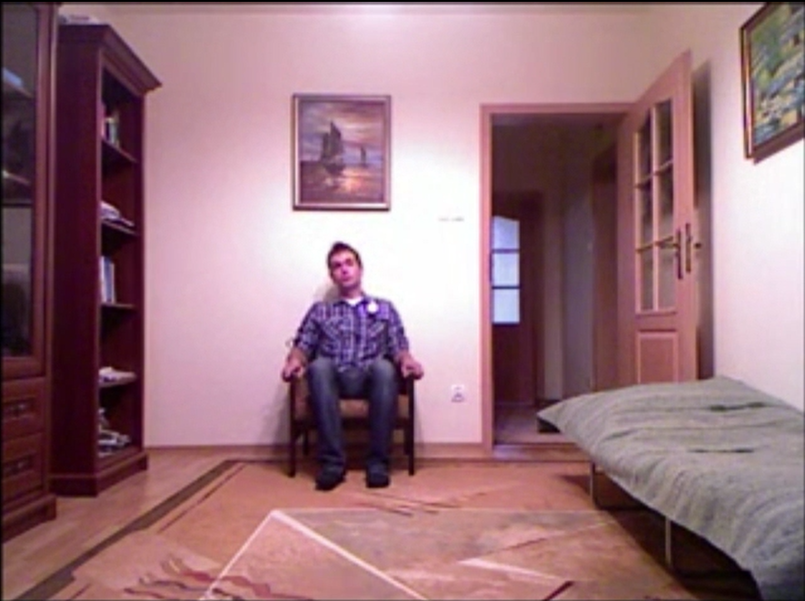
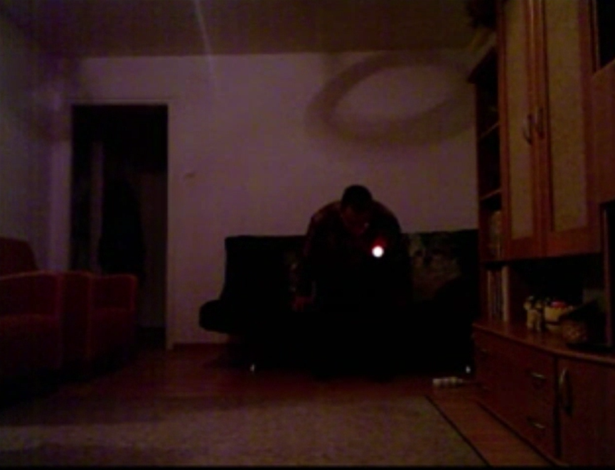
Datasets used
Own dataset contains 4 different positions of 3 activities which are (fall, sit and sit brutally)
50 Ways to Fall contains simulated falls due to myocardial infarction, imbalance, falls from heights, etc.
UR Fall Detection Dataset includes 35 Falls videos and 35 activities of daily living. Published by University of Rzeszow.
Figure 9: datasets example. From left to right ( fall, sit, sit brutally)
Figure 10: datasets example of 50 ways to fall.
Figure 11: UR Fall Detection Dataset.
Reference:
Bogdan Kwolek, Michal Kepski, (2014) Human fall detection on embedded platform using depth maps and wireless accelerometer, Computer Methods and Programs in Biomedicine, Volume 117, Issue 3, December 2014, Pages 489-501, ISSN 0169-2607
Kevin Parry. (2019). 50 ways to fall. [video]. Flikr..https://www.youtube.com/watch?v=8Rhimam6FgQ
Notes:
The banner on subsequent slides should contain your name, project title and affiliation. You need to change this information in the “Slide Master” (View -> Slide Master). The total number of slides needs to be changed in the “Slide Master” too.

Slide 7
Results/Output
Dataset | Total poses | Fall | Non-Fall | Accurate Fall | Accurate Non-Fall
Own Dataset | 12 | 4 | 8 | 3 | 8
50 ways to fall | 82 | 50 | 32 | 49 | 31
UR Fall Detection Dataset | 110 | 35 | 75 | 31 | 71
Dataset | Fall Accuracy | Non-Fall Accuracy | Total Accuracy
Own Dataset | 3/4 | 8/8 | 91.67%
50 ways to fall | 96.00% | 93.75% | 95.12%
UR Fall Detection Dataset | 88.57% | 94.67% | 92.73%
Figure 12: Output of fall detection
Notes:
The banner on subsequent slides should contain your name, project title and affiliation. You need to change this information in the “Slide Master” (View -> Slide Master). The total number of slides needs to be changed in the “Slide Master” too.

Slide 8
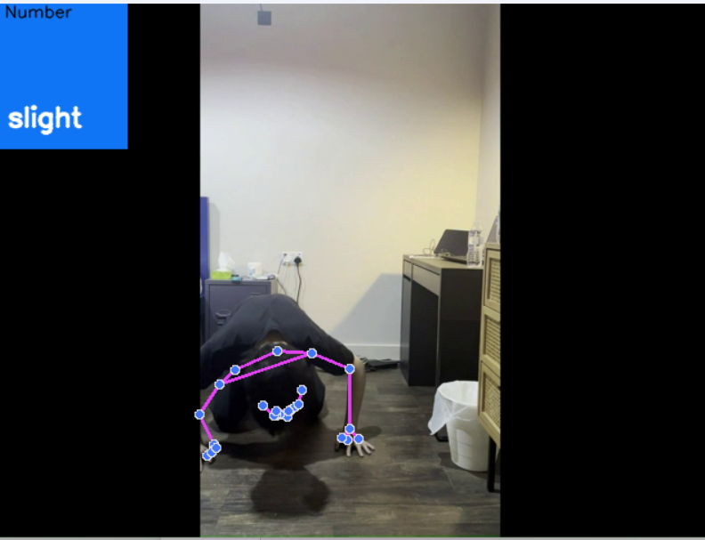
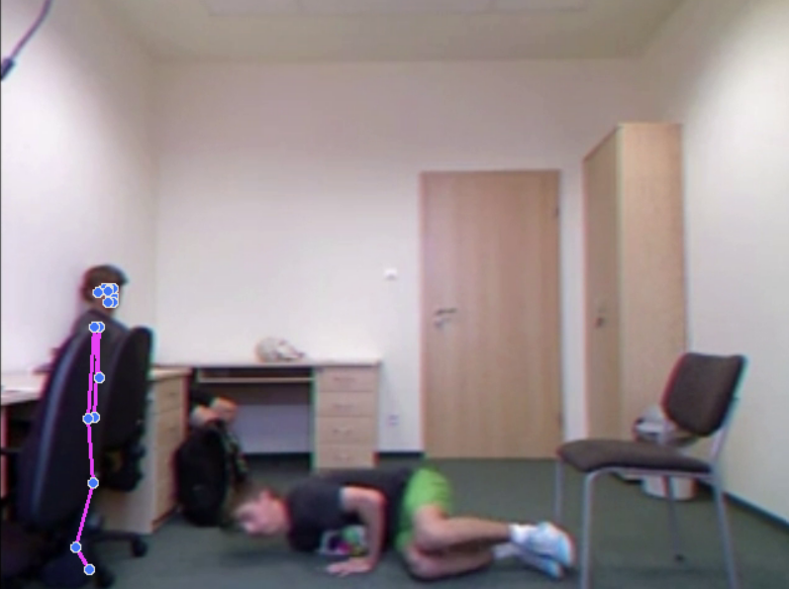
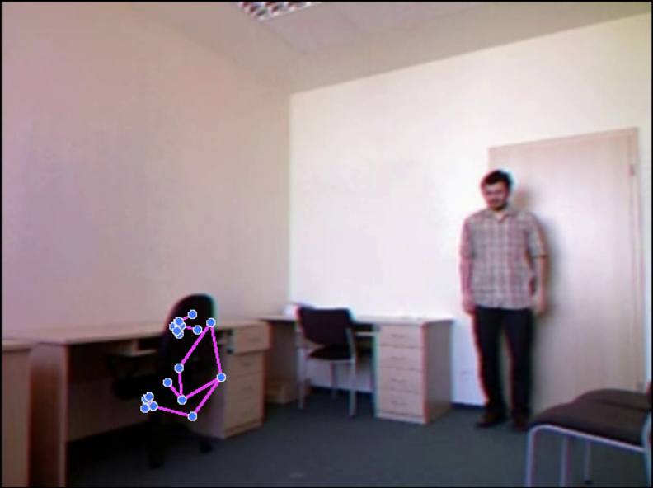
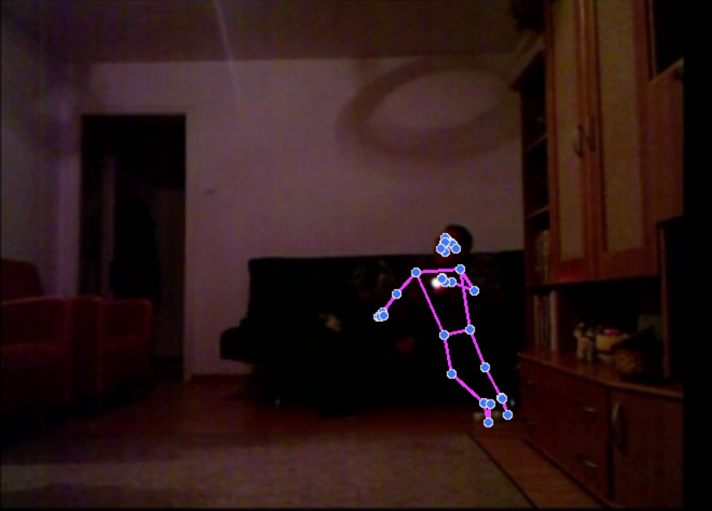
Potential Problems
Own dataset
When a fall occurs directly in front of the camera, most of the body limbs cannot be detected by the Mediapipe. This results in a failure to recognize the fall.
UR Fall Detection Dataset
When more than one person is present in the same scene, there may be problems with judgement. Also, the recognition of an object as a human body can occur if the light is too dark or if there are too many objects around.
Figure 13: Front fall detection result
Figure 14: Detection failure (two people)
Figure 15: Detection failure (chair)
Figure 16: Detection failure (dark)

Slide 9
Future work
Improve the accuracy so that the algorithm won’t be confused by poses like getting down to find something or lying down.
Make a push notification software for mobile phone so that it can receive the picture of the elderly fall or falling.
Enable the transfer of data from the surveillance camera to the computer so that it can be used in a wider range of scenarios.
Notes:
The banner on subsequent slides should contain your name, project title and affiliation. You need to change this information in the “Slide Master” (View -> Slide Master). The total number of slides needs to be changed in the “Slide Master” too.

